Slide 1
TreeSafe or “Sonograms for Trees”
A non-invasive way to predict the structural integrity of trees.
Notes:
Tree Safe
The ability to predict which trees will fall on houses or power lines in the next storm will saves lives, property and money. This ability will save homeowners, town and city governments millions of dollars in repair and replacement costs plus lower insurance premiums. TreeSafe is a non-invasive technique that determines the viability of a tree that is infested with carpenter ants using acoustic waveform transformation algorithms, software application, database and a handheld computer such as a laptop, smart phone or tablet. With only 2 or 3 samples, this system can predict the degree of infestation with sufficient confidence that the homeowner, landscaper, power utility worker can decide if the tree is safe or not. No other commercially available system is this simple or efficient.

Slide 2
Diseased trees cost money
Estimated cost to take down 1 tree is $100 - $1,500, depending on size, location, etc.
Estimated cost of 1 tree falling on a house could be $1,000 - $200,000 depending upon size, location, house value.
Trees falling on power lines start fires that destroy property and injure people.
A low probability event with high catastrophic outcome.
Notes:
Tree maintenance and removal can be expensive, especially if a tree falls on your house. The $200K estimate was for a house in Brentwood, CA. Trees fall on power lines and spark fires. Although this type of incident is low probability, the consequences are high.

Slide 3
Carpenter Ants - Cause or Effect?
Trees attacked by carpenter ants are usually under stress
The tree's primary problem is moisture or decay
The carpenter ants are not the cause of the tree's decline but an effect
They reduce the physical strength of the tree and quality of the wood.
Either way, the tree is in decline
Notes:
Carpenter ants are not the cause of tree decline, rather the effect of fungus or disease or excessive moisture or rot. They are opportunistic insects, merely seeking a low humidity protected environment to raise their young. So if you detect carpenter ants in a tree, then the probability is greater than zero that the tree is not healthy and is in slow decline. TreeSafe is a device that will tell you an estimated probability of that decline and how compromised the structural integrity really is.

Slide 4
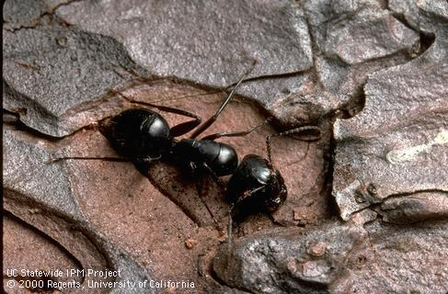
What carpenter ants do.
In natural settings, they excavate into the heartwood of living trees or into dead trees.
From here they can expand the nest into sound wood and compromise structural integrity.
Notes:
Carpenter ants live in live or dead wood, houses, or wherever the humidity and environment suits them.

Slide 5
Ant Colonies
Big Black Carpenter ant colonies are usually of moderate size, some containing over 3,000 workers (up to 10 -15,000 including satellite nests) when maturity is reached in about 3 to 6 years. The typical western carpenter ant (C, Modoc) mature colony contains about 10,000 -20,000 workers, with large colonies having up to 100,000 workers. Developmental time (egg to adult) for workers takes at about 60 days.
Notes:
Carpenter ants can build a huge nest in 3 – 6 years with each nest holding tens or hundreds of thousands of workers. That’s a lot of wood.

Slide 6
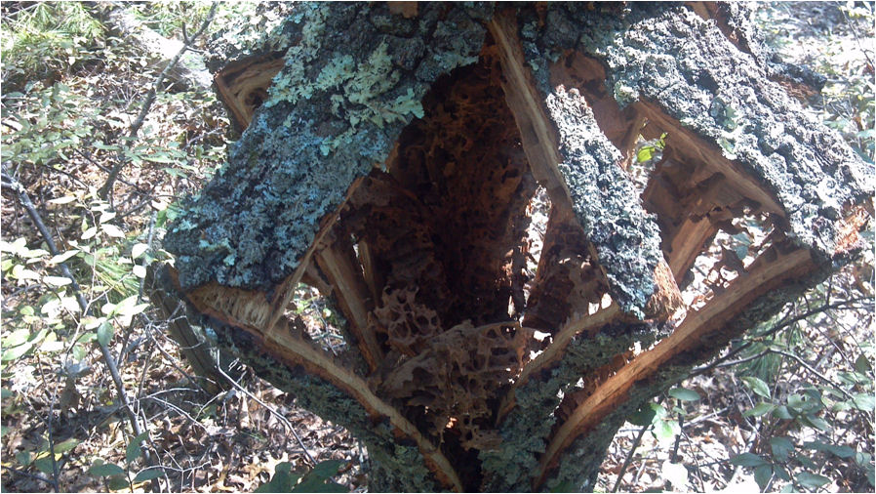
Carpenter ant galleries – 12 inch diameter oak – After Irene
This tree had no exterior indication of structural decay.
Notes:
After Hurricane Irene, I walked through our neighborhood in West Kingston and took a walk through Crawley Reserve. I noticed that healthy trees were not damaged. The trees blown over and snapped at the base were hard wood oaks, not pines. Damaged pine trees were more likely to be snapped off more than half way up the base, not at the base.
Closer examination revealed that the oaks were compromised by massive infestations of carpenter ants. Yet, their external bark and limbs showed no signs of disease or rot or infestation. In other words, you could not tell by looking at the tree if it was compromised – likely to be blown over in the next wind storm or hurricane.

Slide 7
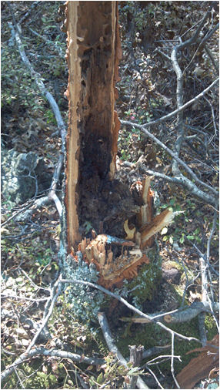
Carpenter ant galleries – small oak – After Irene
Typically, carpenter ants attack below the crown of the tree and build tunnels and galleries vertically.
Notes:
I think there’s a pony in the pile here. Here’s why. The density of wood of a healthy tree, about 1-2 feet above the crown up to 6 feet, is different than that of a diseased or infested hardwood tree. A hardwood tree infested with carpenter ants is perforated with hundreds of cavities or galleries near ground level. If you pass an acoustic sound wave through it, its acoustic signature will be different somehow from a healthy, solid heartwood tree.

Slide 8
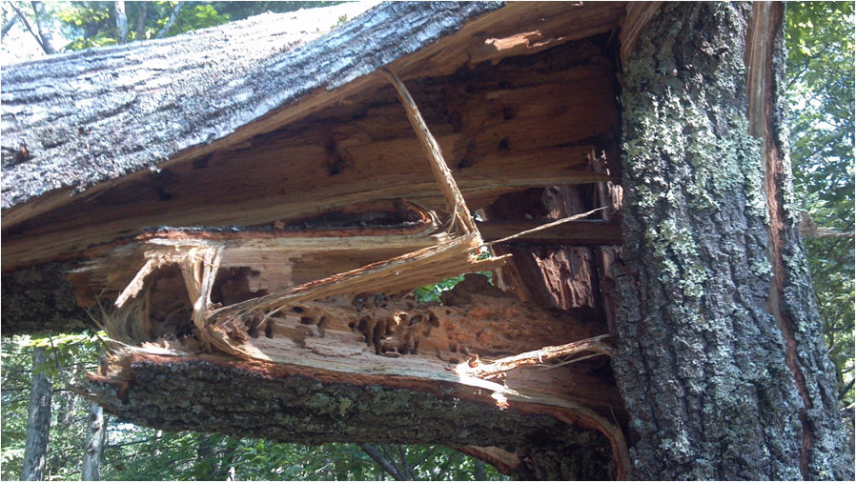
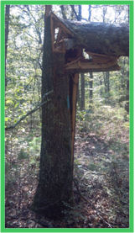
Carpenter ant galleries – 2 ft diameter oak – After Irene
This tree had no exterior indication of structural decay.
Notes:
The PRIME Project I am proposing involves the following scientific disciplines: acoustics, material life sciences, mechanical and electrical design, computer science, and business. Here’s why. Literature and field research in life sciences is needed to discover how healthy trees differs from infested trees in terms of its acoustic signature, taking into account circumference, species, age, etc. There is some recent work in the ultrasound area. Engineering research is needed to determine the most economical mechanical and electrical device to deliver, analyze and record sonic impulses (much like sonar). I stress the word ‘economical’ because if the research shows there is a statistically significant difference between the acoustic signatures of healthy vs diseased trees, then this device and its associated acoustic algorithms and software can be licensed to commercial enterprises. Being able to predict the structural integrity of a tree will save millions in property damage and injuries. But it must be so simple that a utility worker, property owner, or landscape company worker can use it.

Slide 9
Current Decay (Disease) Detectors
‘Sounding’ – simple
  striking a tree with a mallet
  listening for change in pitch
  requires experienced ‘listener’ or operator
  tends to underestimate the extent of decay
  not refined enough to distinguish between sound wood and incipient decay
Notes:
Sounding is the simplest method that involves an experienced ‘listener’ (logger) smacking the side of a tree and making a decision about how sound the tree is based on the tone of the sound. But sounding is influenced by the thickness of the bark, the type of mallet, the experience of the listener – all variables. Which is not good science.

Slide 10
Current Decay (Disease) Detectors
Chemical – complex
  Based on detecting acetic acid and other fatty acids
  Requires incremental coring
  Damages the tree, creating wounds in the bark and cambium.
Notes:
A chemical method involves coring and boring into the tree which takes a lot of time, offers insects and bacteria a vector into the tree. It involves chemicals and a bunch of hardware to determine if the tree is at risk. Not recommended.

Slide 11
Current Decay (Disease) Detectors
Tomography – complex
  Electric
  Geo-radar
  Ultrasonic (UDD)
    Most promising method
    Measures signal Time Of Flight (TOF)
    Function of tree diameter
    Species dependent
    Can inflict damaging wounds to tree
Notes:
Tomographic methods are complex. They involve a skilled experienced person to interpret the output of a tree ‘MRI’. UDD method requires driving nails into the tree, striking them with a hammer and recording the results. The technician needs to interpret the tree ‘MRI’ to determine the degree of decay which requires a hard copy output, time to interpret, multiple trials, and a lot of time. Not recommended.

Slide 12
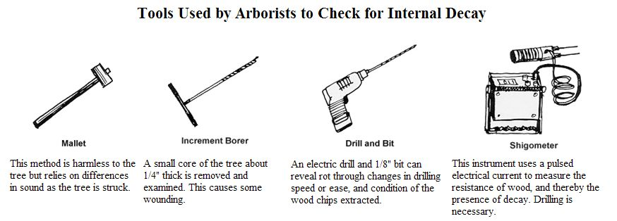
Current Methods
Most are invasive and damage the tree
Require multiple tools, techniques, and skills
Notes:
Here are some of the tools that technicians use to determine the health of a tree. From extremely simple to very complex. They require drilling, coring, boring, interpreting complex data. Not recommended. We need something much less complex in terms of skills, hardware, damage to the tree, time, and personnel. Timber is a multimillion dollar business in New England.

Slide 13
Current UDD Discrimination
Waveform A shows the energy amplitude (volts) versus time (microseconds) for sound wood.
Waveform B shows advanced decay or a hole.
A
Amplitude
Time
B
Amplitude
Time
Notes:
Here are two of several types of graphs that depict waveforms based on different types of wood decay or cavities. The waveforms are different and current methods rely on an expert observer to discriminate what these waveforms mean in terms of tree structure. I believe this discrimination can be performed by algorithms, software applications, and cumulative knowledge collected by an online database. In other words, this system gets better with each diagnosis. It is not a standalone system but uses a knowledge base online and updated continuously. TreeSafe does the work of categorizing the decay. The operator is the interface between the customer and commercial outfits.

Slide 14
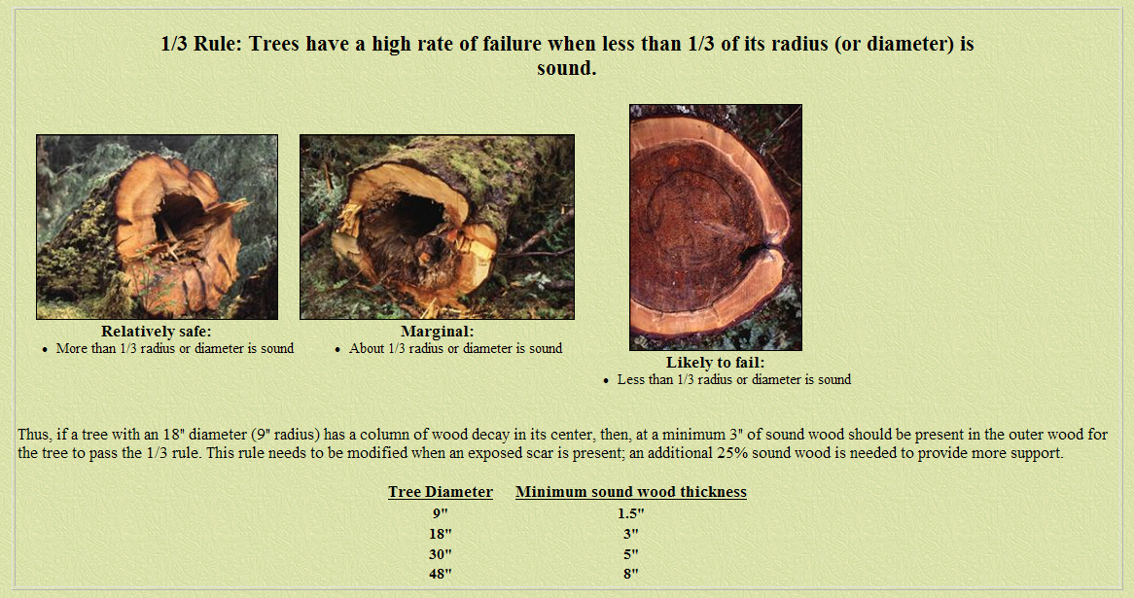
Some guidelines exist
Data available for the ‘1/3 Rule’
Notes:
There are some rules of the road to follow in categorizing decay. Here is the 1/3 rule. Maybe 4 categories are better. TreeSafe categorizes the decay based on the waveform analysis and provides the customer with a probability, like ‘25% decay’ or 75% decay. This quantifies the decay and lets the customer or user decide if they want to take down the tree based on the analysis and other factors like proximity to structures, power lines, etc.

Slide 15
PRIME Problem Statement
Research and design a non-invasive, inexpensive, simple system that consists of…
A transducer to transmit the signal to…
A smart phone, tablet, or laptop…
And acoustic waveform analysis algorithm, software application and database…
To determine with reasonable degrees of certainty (1/3 rule or better)…
If a tree is infested with carpenter ants…
Without requiring skilled image or acoustic signal interpretation.
Notes:
Here is a synopsis of the PRIME problem. TreeSafe uses COTS hardware (laptop, tablet, transducer), application specific software, and wireless interface to compile the data and analysis into a form that is emailed to the customer. No printouts required. No paperwork. TreeSafe does that for the user – all displayed in a fill in form and emailed to the customer at the site.

Slide 16
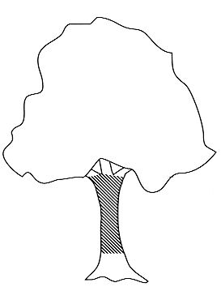
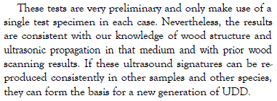

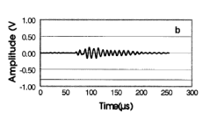
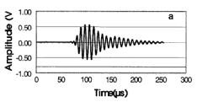
Notional System
Wireless upload / download
Report
Laptop
Smart Phone
Impact
device
Tablet
Transducer
Laptop, smart phone or tablet software analyze input, compare to online data base info and display results in PDF auto-fill form.
TreeSafe app collects and formats gps, webcam, text and data for email pdf attachment to addressee.
Basic tree dimensions, photo, GPS data collected, impact device creates shock wave, transducer receives and transmits.
Notes:
Here is a notional TreeSafe system consisting of the impact device, the transducer (connected to a laptop or tablet), hardware and software with wireless connection for sending the report to the customer email address.

Slide 17
Notional System Architecture
HARDWARE
SOFTWARE
Laptop
Tablet
Smart Phone
Algorithms
Transducer
Application
Cabling
Database
Connectors
Server
Impact
Device
User
Interface
Notes:
Here is a notional system architecture for TreeSafe.

Slide 18
Approach – First Year
Form a PRIME Team of students in mechanical and electrical engineering, computer science, and business
Determine system and subsystem requirements
Develop approach and system design
Enlist cooperation of landscaping or logging companies plus National Grid
Develop software algorithms, application, and database
Notes:
I believe a commercial product or service could be developed much like ‘DigSafe’ and offered to townships and landscapers around the country. This project will get students involved in real world solutions to problems, possibly create business, and, hopefully, generate income for Rhode Island.

Slide 19
Approach – Second Year
Perform field research with clients, i.e. National Grid, local landscaping and tree companies
Refine models and algorithms
Prototype hardware for commercial use
Develop business plans
Notes:
I quote from URI President David M. Dooley “Transformational Goals for the 21st Century”:
“One of our essential roles as the state’s flagship university is to work with the public and private sectors to create a vibrant and sustainable Rhode Island economy. We are uniquely positioned to increase the knowledge base through research, to convert new intellectual property into economic development, to establish jobs and small businesses, to produce business and industry leaders, and to provide critical expertise and innovative solutions to businesses, governments, and other who seek our assistance.”

Slide 20
References
“Using Ultrasound to Detect Defects in Trees: Current Knowledge and Future Needs”; Leininger, Schmoldt, Tainter; 2001.
“Application and Comparison of 3 Tomographic Techniques for Detection of Decay in Trees”; Nicolotti, et.al,; 2003.
Notes:
There is some recent research on this topic.
http://www.srs4702.forprod.vt.edu/pubsubj/pdf/01t34.pdf
http://waset.org/journals/waset/v2/v2-40.pdf

Slide 21
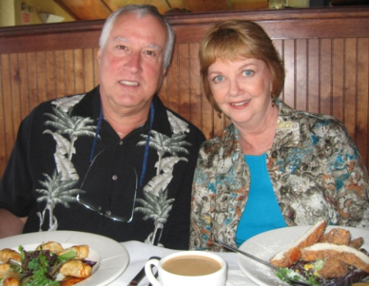
My Background
BA (Psychology, Biology), URI, 1971.
MA (Engineering Psychology), NMSU, 1974.
Senior Staff Human Factors and Systems Engineer, Lockheed Martin, Sunnyvale, CA, 1974-2007.
Applied human factors engineering principles and design standards to mobile shelters, large facilities, missiles, ships, planes, spacecraft, command centers, equipment racks and consoles, transportation systems, handling fixtures, railcars, support equipment, and computer human interfaces.
Worked with mechanical and electrical engineering, systems engineering, manufacturing, training, logistics, parts, materials and processes, facility and field engineering and DOD customers and suppliers.
Taught Specialty Engineering, CONOPS, HFE classes.
Certified Human Factors Engineer #529.
Retired 2007 after 33 years in aerospace industry.
Married Julie Yingling (URI 1970) September 2008.
Moved to West Kingston, November 2008.
Rick and Julie at Turtle Soup.
Notes:
I started out in the URI College of Engineering but couldn’t quite understand all those forces and vectors in statics and dynamics. I passed slide rule and math but I flunked statics and decided engineering wasn’t my calling. I was graduated in 1971 with majors in psychology and biology, and minors in stat and speech and hearing. Al Lott recommended I get a graduate degree at NMSU because it was far away from home, had a low student/faculty ratio, and the profs were from great universities. So I tried ‘engineering psychology’ at NMSU which focuses on understanding the capabilities and limitations of humans and applying that knowledge to the design of equipment, user interfaces, and facilities so they are easy to use. In 1974, I got a job at Lockheed in Sunnyvale, CA and stayed there until 2007. I worked on ships, planes, communication centers, missiles, spacecraft, submarines, health care delivery systems and other things that ‘go bump in the night’. Never a dull moment except between jobs when you’re looking for new work which was pretty often…. I retired in 2007, got married in 2008, and looked for a place to retire. Which turned out to be Rhode Island which is pretty amazing because most people leave RI and don’t retire here. But it’s worked out very well.

